Slide 1

Presentation Template
Assist. Prof. Lu WANG (王露)
City University of Hong Kong
Department of Mechanical Engineering
E-mail: lu.wang@cityu.edu.hk
Web: https://www.cityu.edu.hk/mne/wang/

Slide 4
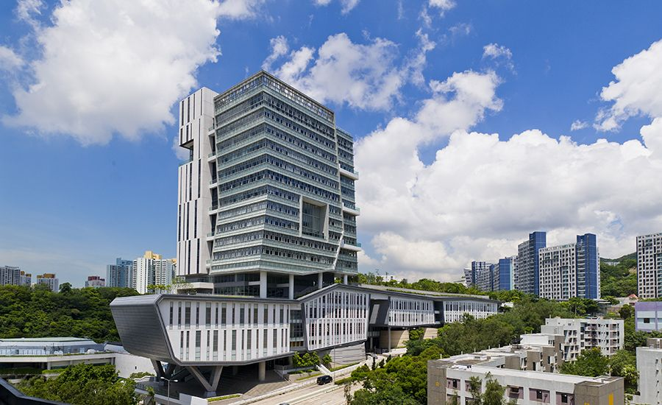
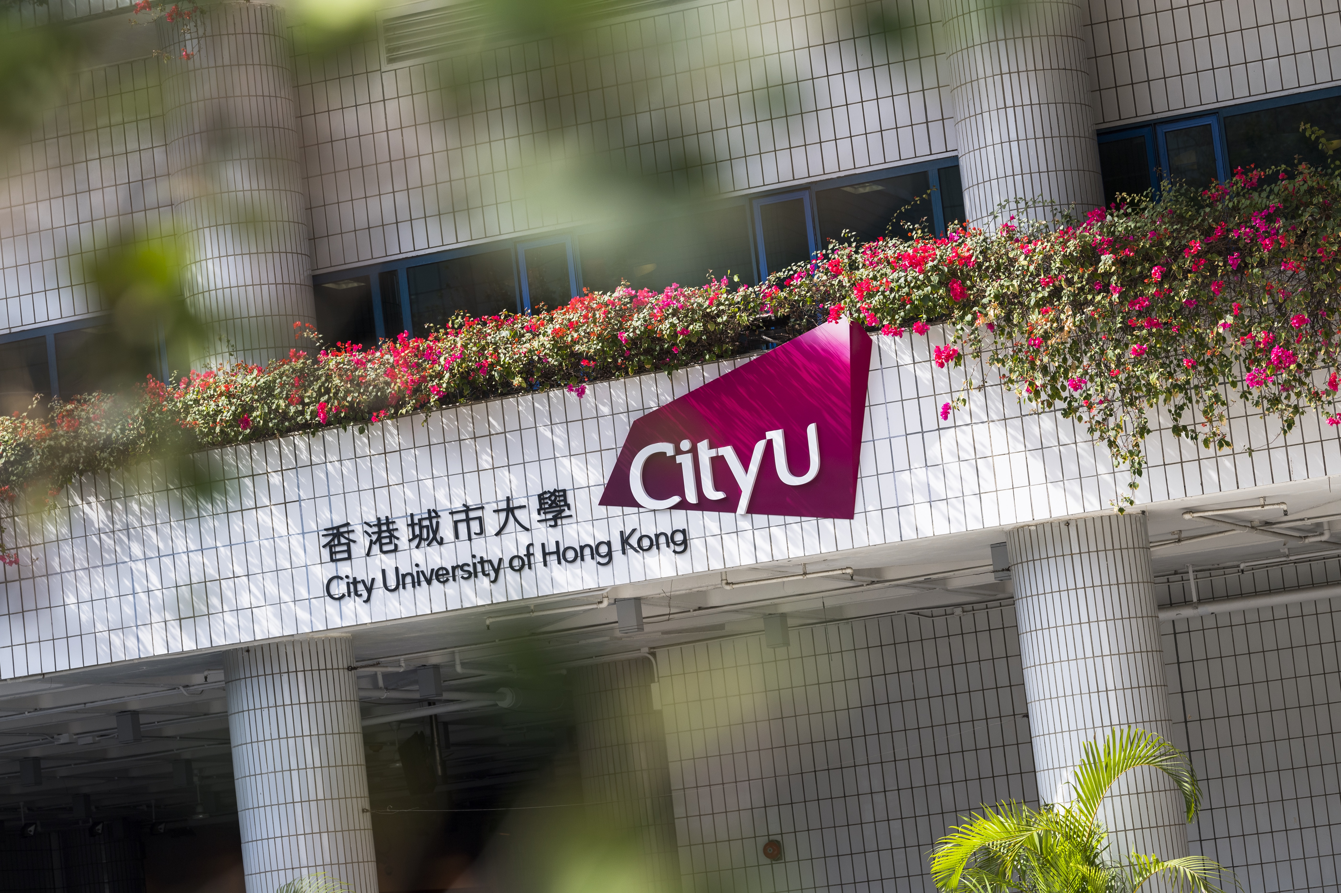
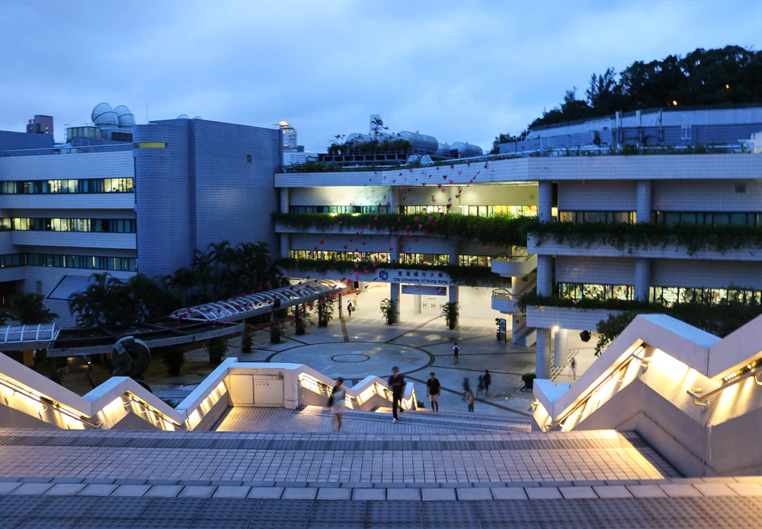
Q & A
Thank You for Listening!

